Slide 1
Highways and words: Migration patterns and linguistic diversity
Anjali Bhatt & Molly Lewis
June 30th, 2017
Summer Institute in Computational Social Science

Slide 2
Motivation
Methods
Findings
Next Steps

Slide 3
Cultural diversity matters
Culture is a defining attribute of human behavior in communities
Diversity enables innovation, human understanding, and other forms of social and economic progress

Slide 4
Language is a window into culture
Provides insight into how people construe meaning from their experiences
Is a vehicle for how communities negotiate, codify, and uphold norms, values, and beliefs

Slide 5
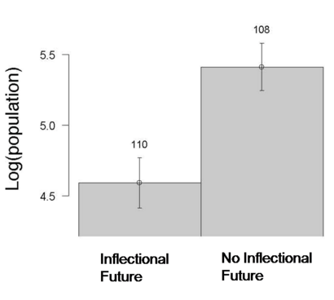
What are the sources of linguistic variability?
Linguistic Niche Hypothesis (Lupyan & Dale, 2010): Language systems adapt to their environments
Learnability pressures as one factor influencing the morphological complexity of a language
E.g., languages spoken by many second-language learners should be structurally simpler
Notes:
What accounts for this variability?
A A helpful distinction for thinking about this hypothis is different timescales
CORROLARY of this hypohties
This suggestsion --- that environmental pressures may shape language evolution – has been termed the LHN
A mechanism over multiple timescales
… and this might account for the variability across languages
* process of checking
translation for you. By detecting patterns in documents that have already been translated by human translators, Google Translate can make intelligent guesses as to what an appropriate translation should be.
This process of seeking patterns in large amounts of text is called "statistical machine translation".

Slide 6


Linguistic Niche Hypothesis
vs.
vs.
vs.
t
In-the-moment timescale (minutes)
(Nettle, 2012)
Notes:
Evidence for relationship between these pressures and features of language at many levels of linguistic structure (Atkinson, 2011; Hay & Bauer, 2007; Wichmann, Rama, & Holman, 2011; Bentz, Verkerk, Kiela, Hill, & Buttery, 2015; Lupyan & Dale, 2010; Bentz & Winter, 2013).
Density of speakers
Variability in speakers
Aspects of theobysucal environment
A helpful distinction for thinking about this hypothis is different timescales
A CORROLARY of this hypohties
This suggestsion --- that environmental pressures may shape language evolution – has been termed the LHN
A mechanism over multiple timescales
… and this might account for the variability across languages
* process of checking
translation for you. By detecting patterns in documents that have already been translated by human translators, Google Translate can make intelligent guesses as to what an appropriate translation should be.
This process of seeking patterns in large amounts of text is called "statistical machine translation".

Slide 7

What explains within-language variation?
Linguistic patterns differ based on cultural customs
E.g., accents, formality, inside jokes, word innovation
Both for spoken and written communication
“Code-switching” in more culturally diverse communities

Slide 8
Migration patterns are a potential mechanism
Movement of individuals across communities can generate cultural diffusion
In this study we indirectly examine mobility patterns through proximity to highways
Hypotheses
Towns further away from highways are more linguistically homogenous
Towns further away from highways are more linguistically distinctive from each other
Can highways be cultural connectors?

Slide 9
Motivation
Methods
Findings
Next Steps

Slide 10
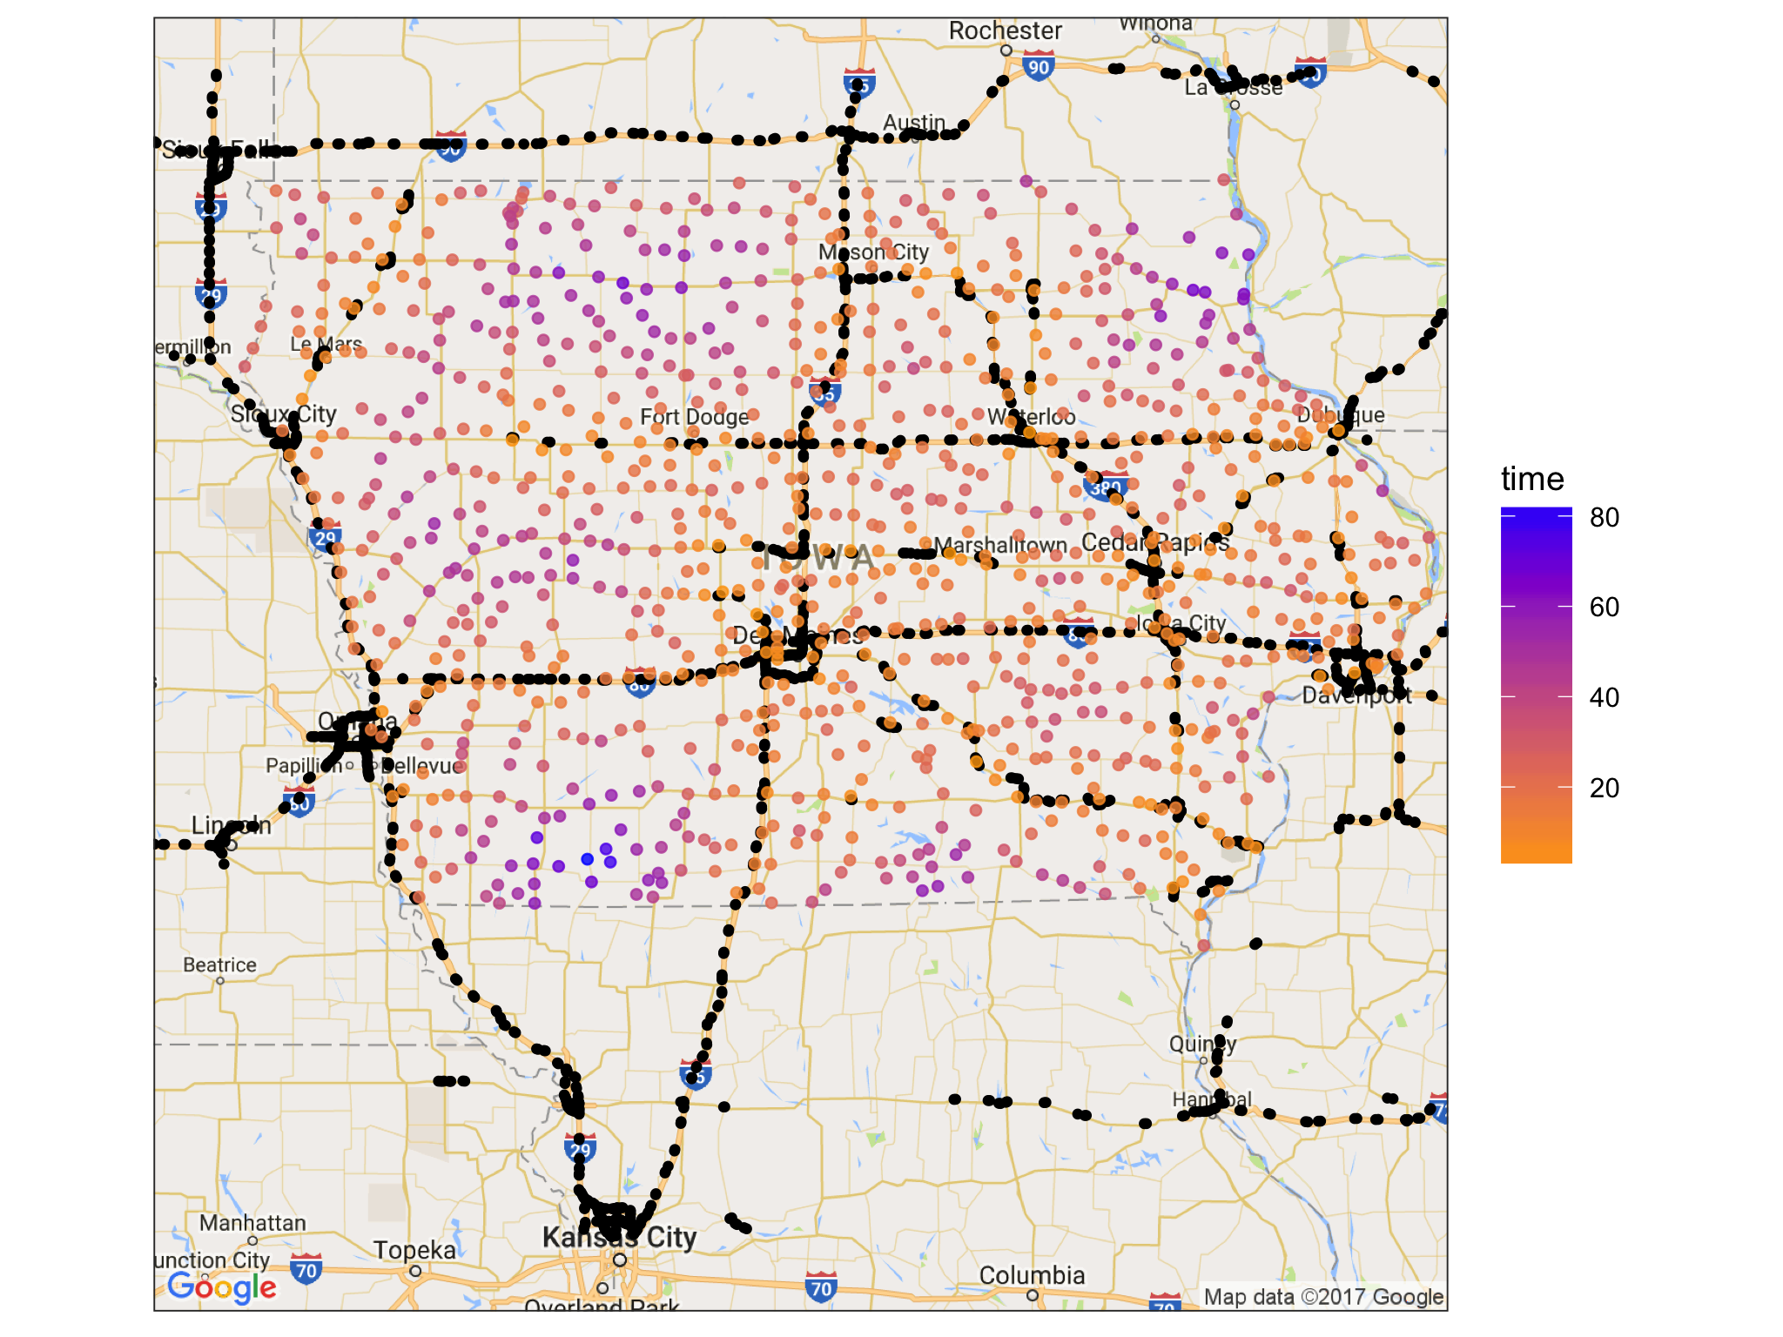
Iowa as a pilot
Highway exits from OpenStreetMap (includes nearby exits outside of Iowa)
946 incorporated cities in Iowa, excluding Des Moines
Driving time to highway ranges from 2 to 83 min (median of 20 min)

Slide 11
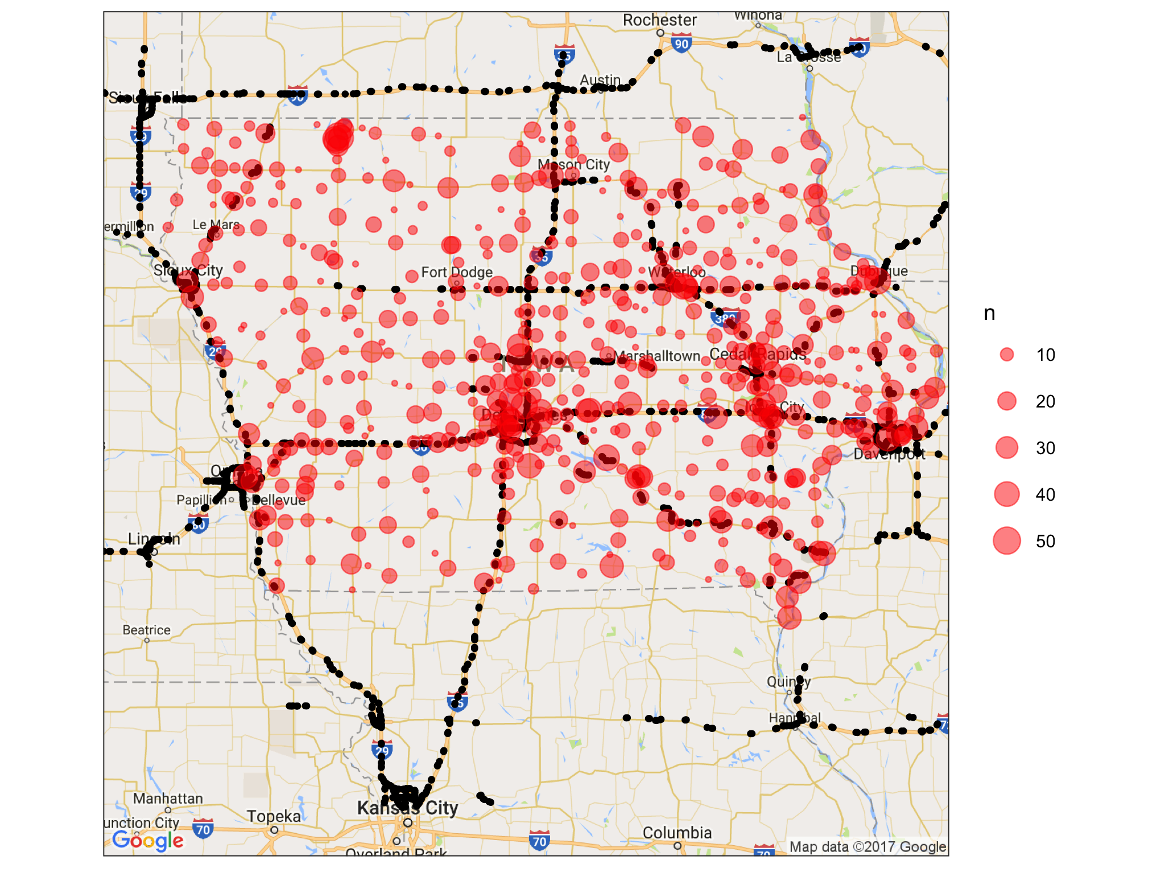
Text from Google place reviews
Fetch all reviews for establishments within a 5km radius of city centers
24,469 total reviews
Retain 546 cities with at least 5 reviews

Slide 12
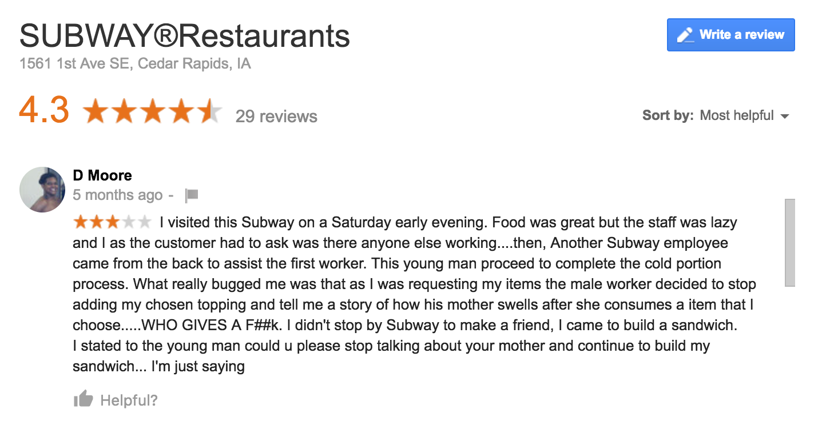
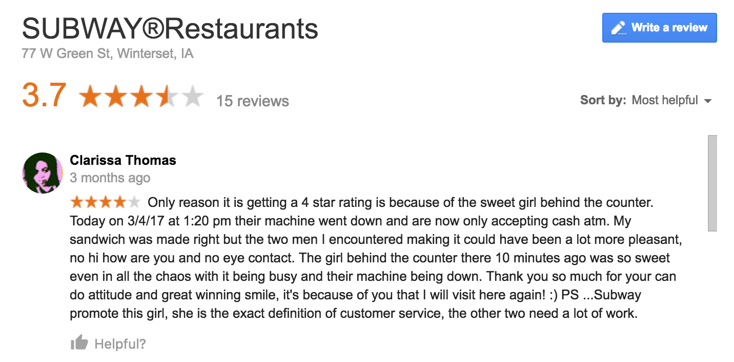
Text from Google place reviews

Slide 13
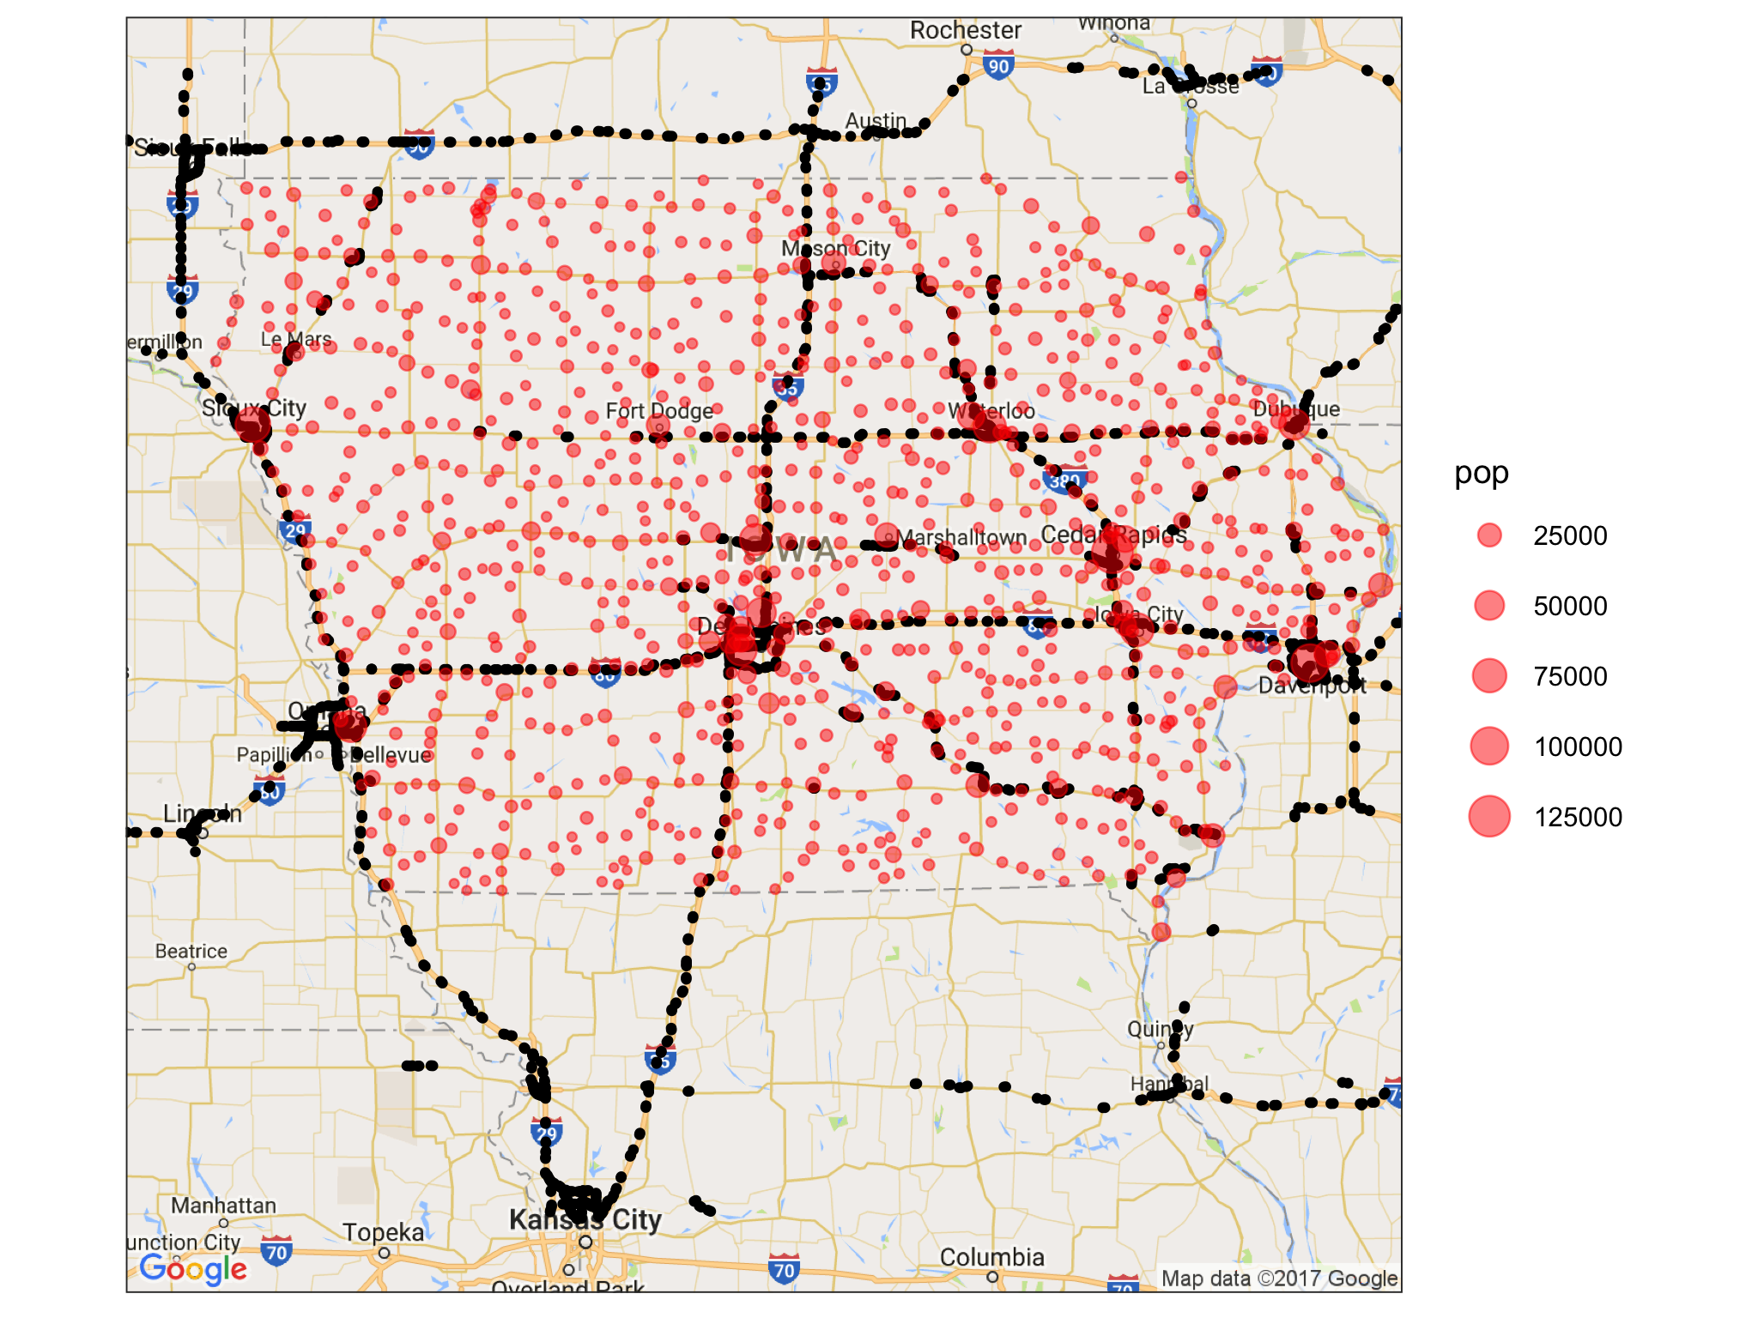
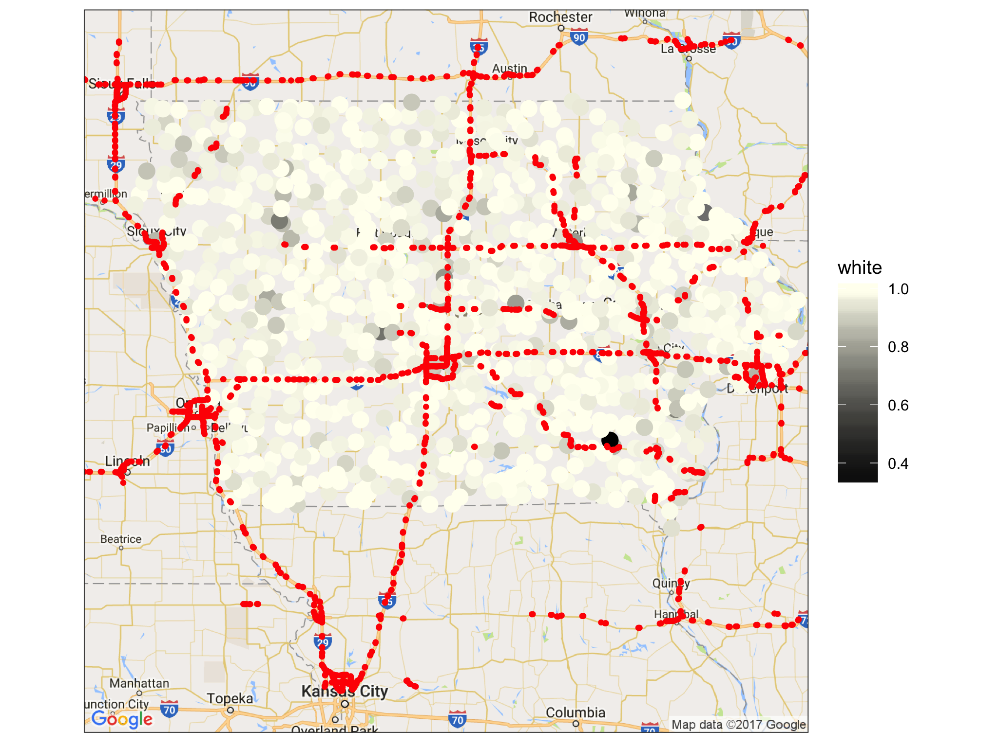
Demographic data
Still need to incorporate data from census on population size, race/ethnicity, income, age, etc.

Slide 14
Motivation
Methods
Findings
Next Steps

Slide 15
Linguistic features

Slide 16
Emotion and distance
Positive Sentiment: r = .13
Log. Prop. Exclamations : r = .1
Log Prop. Capitalization: r = .15

Slide 17
Within-town linguistic diversity
Is town x more varied linguistically than town y?
Multiple levels of variation
Vocabulary
Topics
Usage patterns
How to measure this?
Type-Token Ratio: Number of distinct words in each “corpus” (= town)
But, not measure of within-town variability
Highly correlated with length

Slide 18
Linguistic Distinctiveness
We haven’t yet explored this yet
Will examine whether isolated towns use most distinctive vocabularies, syntax, etc.

Slide 19
Motivation
Methods
Findings
Next Steps

Slide 20
Future Directions
Account for heterogeneity:
Demographics
Content variability (e.g., only examine Subway ® or pharmacies)
Variability in # reviews
Different measures of linguistic diversity/distinctiveness
Different measures of migration
Inflow and outflow in cities (e.g., Craigslist ads)
Employee movement between organizations
Gentrification patterns

Slide 21
Thank you!
ambhatt@stanford.edu
mollylewis@uchicago.edu

Slide 22
Appendix

Slide 23
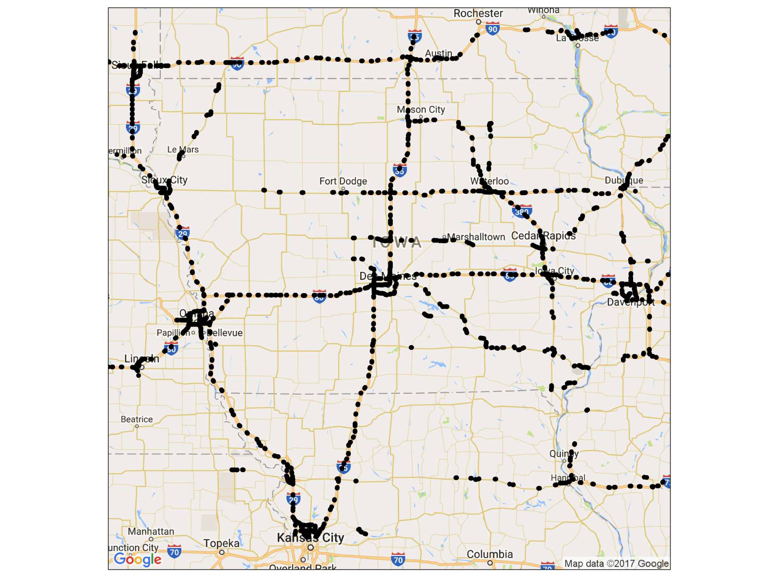
Highway Exits

Slide 24
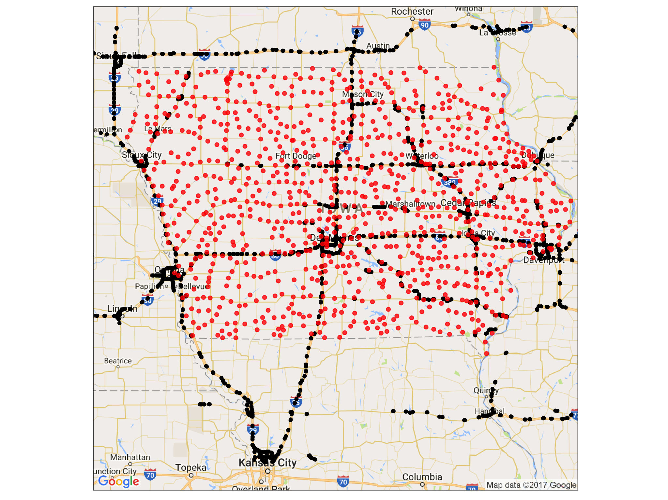
Towns in Iowa

